Slide 1
CS499 - Open Source software development
Lecture #00: Basics
Dr. Igor Steinmacher
e-mail: Igor.Steinmacher@nau.edu
Twitter: @igorsteinmacher

Slide 2


Slide 3
Introductions
Igor Steinmacher, PhD
Assistant Professor
Interested in behavior in Software Development
Mainly Open Source
This course
Real world practice
Real world problems

Slide 4

Let me know what you know
Check the most appropriate:
I have never heard about Open Source
I’ve heard about Open Source, but I am not sure what it is
I know what Open Source is, but just in theory
I know what it is and I use it.
I use and have contributed to Open Source
I use and am a long-term contributor of Open Source

Slide 5
Let me know what you know
With a few words, tell me:
What defines open source?

Slide 6
Let me know what you know
With a few words, tell me:
What do you expect from this course?

Slide 7
This Course: What to Expect
Work!
First half:
SEVERAL assignments
Short tests (biweekly)
Readings + presentation (biweekly)
Second half: one multi-part assignment
Learning Open Source
Philosophy
Tools
Development Process
Practice in a controlled environment, probably.
Guest lectures: diverse perspectives, stories, know-how

Slide 8
Basics
Open source
License
Community
Freedom
Knowledge for all

Slide 9
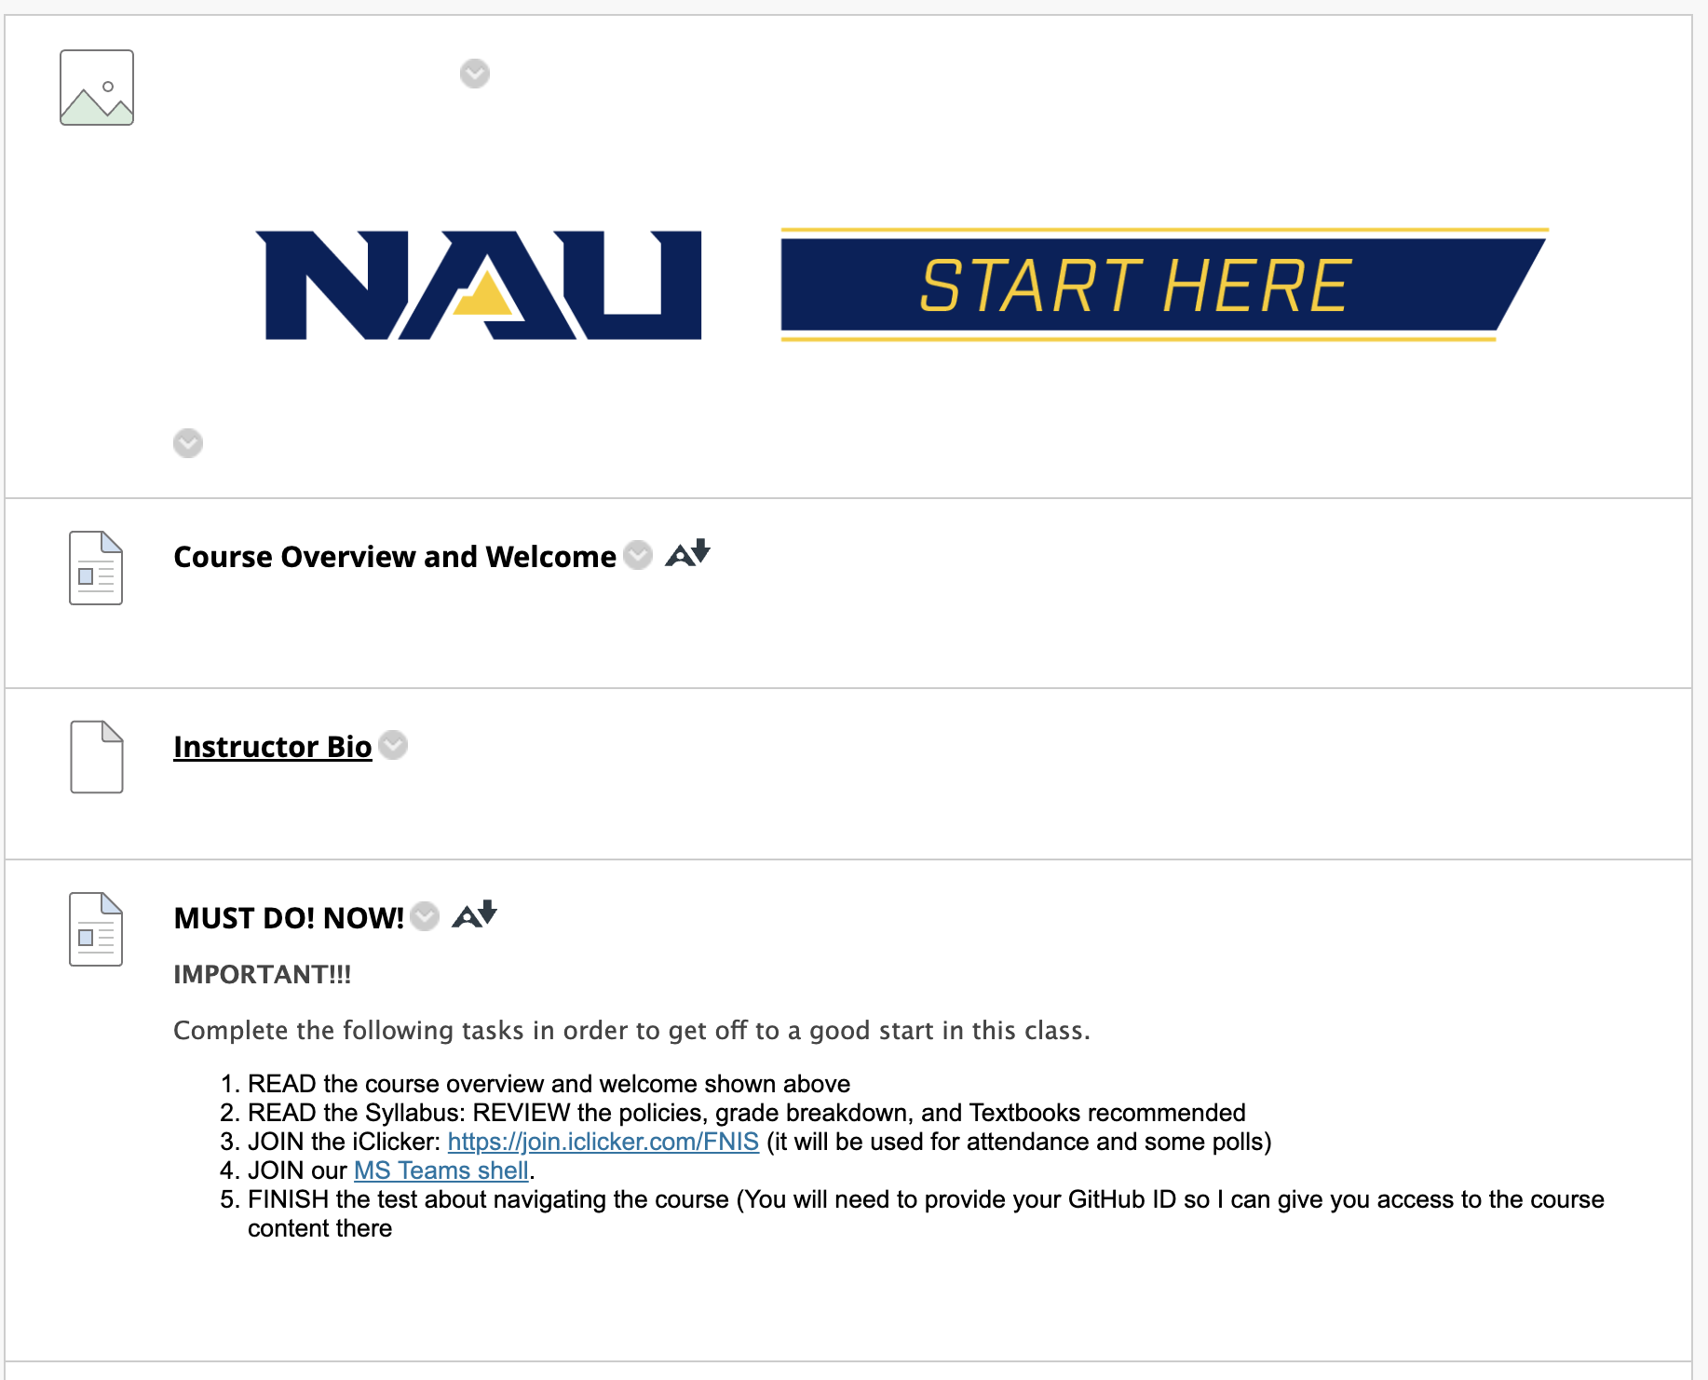
Basic Course Info module
Read ALL the information in that page
Join MS Teams (if you haven’t yet)
Join iClicker (if you haven’t yet)
Read the Syllabus thoroughly!
Take the Course Navigation Quiz

Slide 10
Course Navigation Quiz
You cannot access GitHub, BBLearn assignments or take any exams if you don’t score 100% on this quiz!
You will be required to upload a certificate of completion of you Academic Integrity @NAU for students course

Slide 11
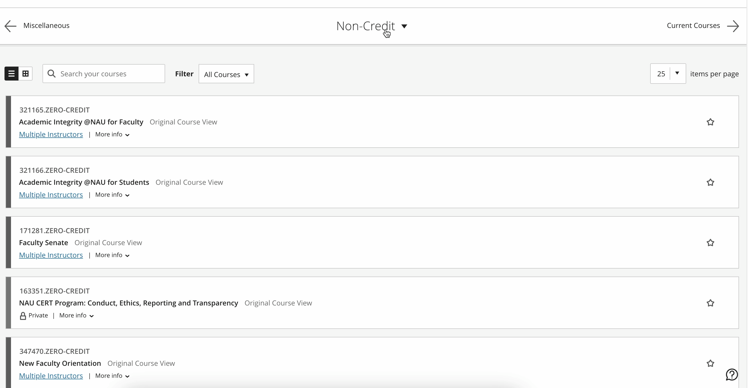
Academic Integrity @NAU for Students

Slide 12
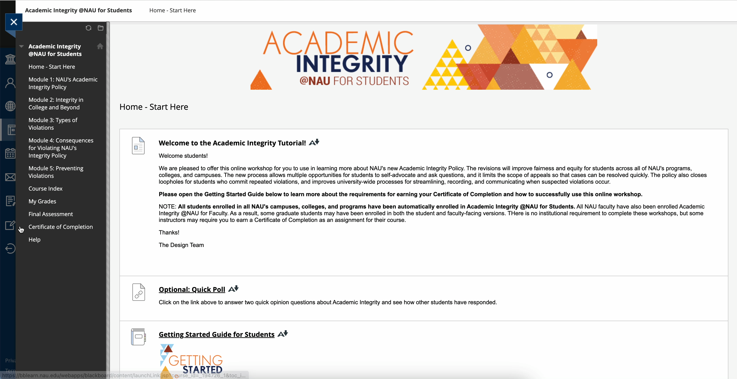
Academic Integrity @NAU for Students

Slide 13
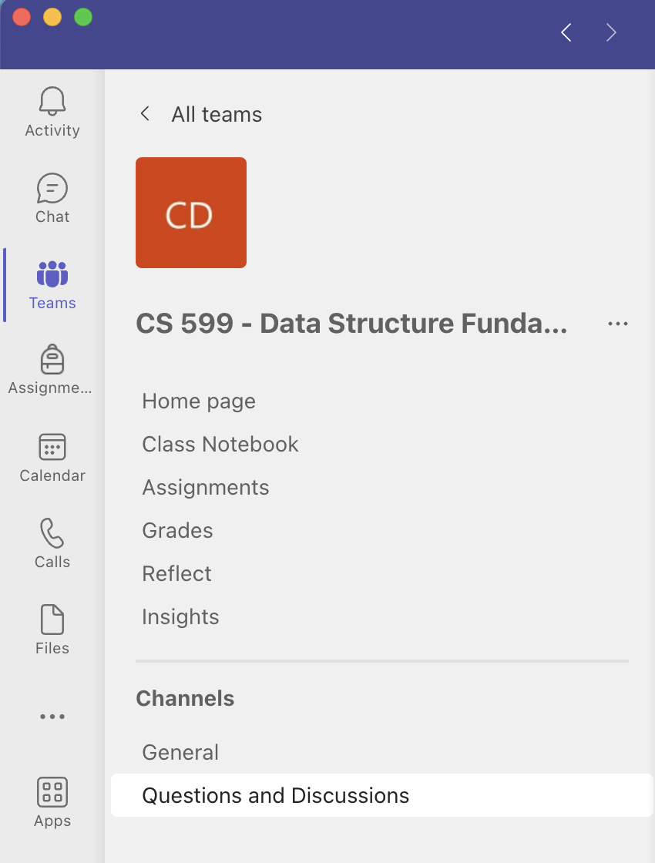
Communication
MS Teams channels (public)
Quick questions
MS Teams private message (private)
Quick questions
Call request during office hours
Email (private)
Appointment request
Action needed
Ana.Chaves@nau.edu
Office hours
In-person, SICCS building, rm 216
MS Teams, link on BBLearn

Slide 14
Communication
Go to the TA first
To ask questions about the subject discussed in class;
To ask questions about assignments;
To get assistance with tool installation;
To review content for exams;
Other…
Go to the instructor first
To ask questions about the grading system;
To request a grade review;
To discuss integrity issues;
To request an excuse for a justified absence;
You found errors in the course materials;
Other…

Slide 15
Communication
During office hours
No appointment is required!
First-come, first-serve
In-person or MS Teams
Be effective, more people may be waiting for their turn
Have your materials ready
Outside office hours
No walk-in
Appointments can be requested by email preferably
Use MS Teams for all that is worth it!

Slide 16
Communication
Common interests should be discussed in class and/or in MS Teams (public channel), so that everyone can participate
Avoid groups for office hours
If you are interested in small groups review and/or instruction, please schedule with your TA
During office hours, I will handle one student at a time, so that I can give personalized attention to the issues at hand

Slide 17
Be aware!
“After class” is not my office hours
Ask your questions during class time (including attendance issues)
If your questions are not answered in class, please come to office hours or use asynchronous communication!

Slide 18
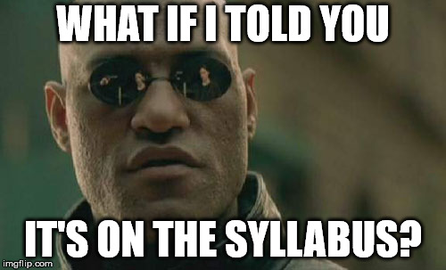
Avoid questions that you already have the answer!
Before asking something to instructors and TAs, READ THE SYLLABUS
Focus on LEARNING, not on chasing a grade
Grades are built throughout the course.

Slide 19
In-class participation
Talk to me
1
Raise your hand and wait your turn to talk
Ask questions
2
It doesn’t show a weakness
It helps everyone to grow!
Answer questions
3
Correct some mistakes I will eventually make
4
Yeah, this happens
It is expected and appreciated.

Slide 20
HW start the day they are assigned…
… not the day they are due!
I will not answer questions at night
I will not answer questions on weekends
I cannot help you 2 hours before the deadline
I cannot help you after you submitted the wrong file/answer

Slide 21
What you should not ask
Round ups
Report iClicker issues past class time
Excuse absences after 48 hours of class
Excuse absences without a justifiable reason
Excuse absence for being late
Turn in assignments after the deadline
Get late assignments graded
Grade review past 1 week of posted grades
Get assignments with wrong extension graded
Get assignments submitted in the wrong place graded
Get opportunities that your classmates don’t have
Turn a blind eye to integrity violation
Drop the course past the Registrar’s deadline
Use your background as an excuse
If you are not sure, check the syllabus!

Slide 22
Do not be late
… for classes
You will be marked absent after 15 minutes of class
… for meetings
I will consider the appointment canceled after 5 minutes of the scheduled time
… for exams
Door closes exactly at the exam time, and you will not be allowed to take the test
… with your assignment
Late work will not be accepted
There is no makeup work for missed assignments

Slide 23
Attendance
I will not fix attendance for you past class time
I trust you! I believe in you! I am still not going to fix it
You start losing grades if you have 3 unexcused absences
You fail the course if you have 11 unexcused absences
Read the syllabus for when and how to request an excuse
Clicking attendance when you are not in class falls into the Fraud/Fabrication category for Academic Integrity

Slide 24
Attendance
3 unexcused absences – 5% penalty in your final grade
5 unexcused absences – 15% penalty in your final grade
7 unexcused absences – 25% penalty in your final grade
9 unexcused absences – 35% penalty in your final grade (probably Fail)
10 unexcused absences – Fail

Slide 25
Administrative drop (first week)
If you fail to click attendance repeatedly in the first couple weeks
If you fail to show up on time
If you fail to interact with the course materials on BBLearn
If you fail to connect to MS Teams channel
If you just stop attending class at some point, you will not be withdrawn from the course automatically

Slide 26
Academic Integrity Violation
NAU takes it seriously, so do I
You may get away with it for some time, but not forever
You would be surprised by how easily we can spot it
Both cheaters and facilitators are penalized

Slide 27
Important
Where to find me:
MS Teams (Check our BBLearn/GitHub page)
Room 090-205 (check the Office Hours or schedule an appointment)
Igor.Steinmacher@nau.edu
Office Hours:
TuTh 08:30 – 09:30 AM

Slide 28
Assignments
Assignment | Planned Deliverable | Weight
Cathedral and Bazaar | Document via BBLearn | 4%
Git/GitHub basics | Exercises with outputs on GitHub + BBLearn | 4%
Code Review | Two-piece-assignment: Code + Review (4% each) | 8%
Create your OSS project | On GitHub: your project | 4%
Domain Analysis of projects | Two-piece-assignment: Checklist (2%) + Analysis (6%) | 8%
 | ASSIGNMENT TOTAL | 28%
SHORT TESTS | 3 Pen/paper tests covering 2 weeks of course | 9%
MIDTERM | Larger test covering the first part of the course | 8%
Presentations | Read 1 paper every 2 weeks (first part of the course). Submit presentation (1/2 groups/day) | 9%
 | TOTAL PART 1 (INCLUDES ASSIGNMENTS) | 60%
Extras | Next Slide | 6%

Slide 29
The Extras! (Maximum of 6 points)
Essays (2 points) → In addition to the ones read for the presentations
A 1-page essay summarizing papers made available
Maximum 1 per student
Participation in Talks (2 points)
Invited talks at SICCS: attend and write a ½ page essay
Maximum 2 per student
Contribution to Wikipedia (2 points)
“relevant” contribution (no typo fixing, or update of 2-3 lines)
Maximum of 1 per student

Slide 30
Assignments
Assignment | Planned Deliverable | Weight
Contribution to Open Source | Decision about project and tasks | 5%
Contribution to Open Source (Checkpoint 1) | * Present the task details/progress report * First impressions/guidelines availability * Architectural analysis (document) | 10%
Contribution to Open Source (Checkpoint 2) | Progress report presentation | 5%
Contribution to Open Source [code Review] (Part of Checkpoint 2) | Code review performed by other group | 5%
Contribution to Open Source (Checkpoint 3) | Final presentation (group + instructor) can be done during office hours Report: Summary of the contribution process (I recommend to be written on-the-fly to avoid forgetting things) | 10%

Slide 31
Navigating our resources
BBLearn
GitHub
MSTeams

